Slide 1
Chapter III – Confidence Intervals

Slide 2
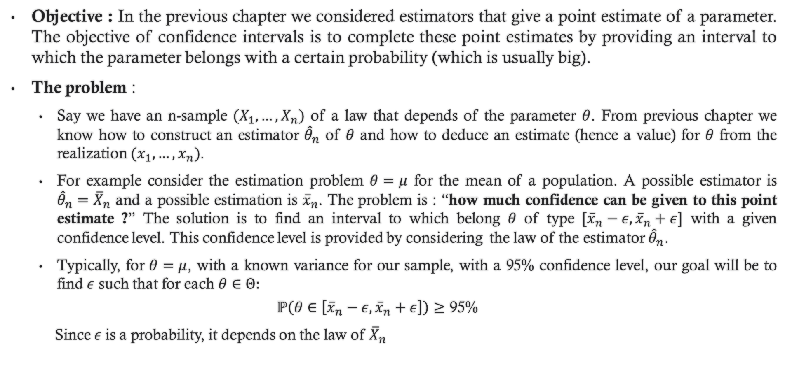
1. Introduction
Objective : In the previous chapter we considered estimators that give a point estimate of a parameter. The objective of confidence intervals is to complete these point estimates by providing an interval to which the parameter belongs with a certain probability (which is usually big).
The problem :
Say we have an n-sample $(X_{1},…,X_{n})$ of a law that depends of the parameter $θ$. From previous chapter we know how to construct an estimator ${\hat{θ}}_{n}$ of $θ$ and how to deduce an estimate (hence a value) for $θ$ from the realization $(x_{1},…,x_{n})$.
For example consider the estimation problem $θ=μ$ for the mean of a population. A possible estimator is ${\hat{θ}}_{n}={\overline{X}}_{n}$ and a possible estimation is ${\overline{x}}_{n}$. The problem is : “how much confidence can be given to this point estimate ?” The solution is to find an interval to which belong $θ$ of type $[{\overline{x}}_{n}−ε,{\overline{x}}_{n}+ε]$ with a given confidence level. This confidence level is provided by considering the law of the estimator ${\hat{θ}}_{n}$.
Typically, for $θ=μ$, with a known variance for our sample, with a 95% confidence level, our goal will be to find $ε$ such that for each $θ∈Θ:$
$$ℙ\left(θ∈\left[{\overline{x}}_{n}−ε,{\overline{x}}_{n}+ε\right]\right)≥\text{95\%}$$
Since$ε$ is a probability, it depends on the law of ${\overline{X}}_{n}$

Slide 3
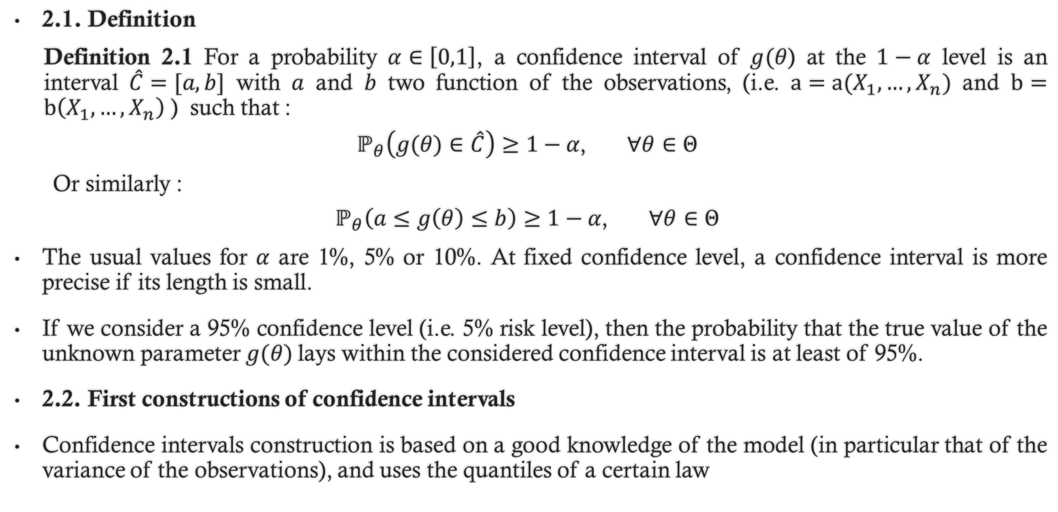
2. Constructing confidence intervals :
2.1. Definition
Definition 2.1 For a probability $α∈\left[0,1\right]$, a confidence interval of $g(θ$) at the $1−α$ level is an interval $\hat{C}=[a,b]$ with $a$ and $b$ two function of the observations, (i.e. $a=a(X_{1},…,X_{n})$ and $b=b\left(X_{1},…,X_{n}\right)$ ) such that :
$$ℙ_{θ}\left(g(θ)∈\hat{C}\right)≥1−α\text{,} ∀θ∈Θ$$
Or similarly :
$$ℙ_{θ}\left(a≤g\left(θ\right)≤b\right)≥1−α\text{,} ∀θ∈Θ$$
The usual values for $α$ are 1%, 5% or 10%. At fixed confidence level, a confidence interval is more precise if its length is small.
If we consider a 95% confidence level (i.e. 5% risk level), then the probability that the true value of the unknown parameter $g(θ)$lays within the considered confidence interval is at least of 95%.
2.2. First constructions of confidence intervals
Confidence intervals construction is based on a good knowledge of the model (in particular that of the variance of the observations), and uses the quantiles of a certain law

Slide 4
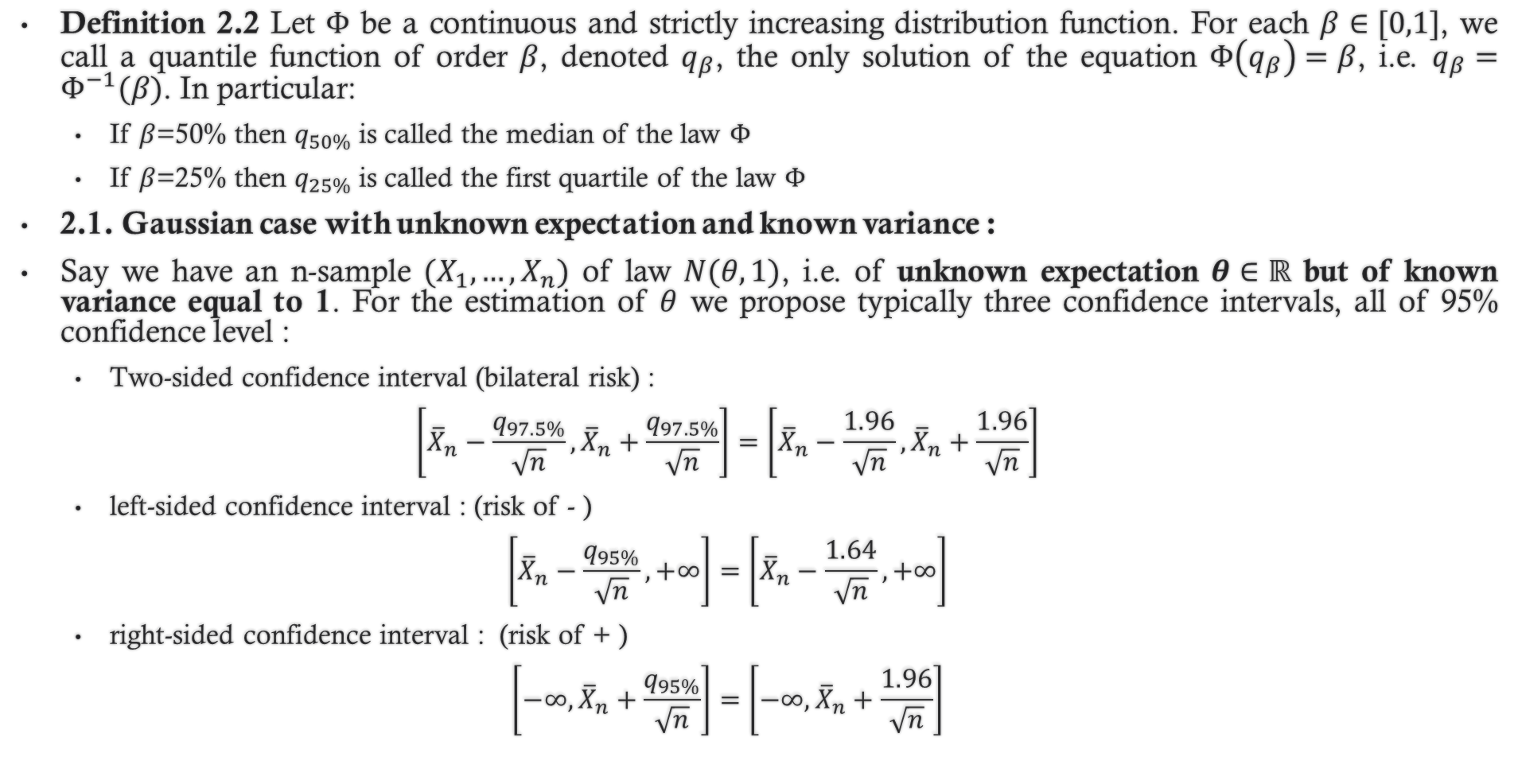
2. Constructing confidence intervals :
Definition 2.2 Let $Φ$ be a continuous and strictly increasing distribution function. For each $β∈[0,1]$, we call a quantile function of order $β$, denoted $q_{β}$, the only solution of the equation $Φ\left(q_{β}\right)=β$, i.e. $q_{β}=Φ^{−1}(β)$. In particular:
If $β$=50% then $q_{50\%}$ is called the median of the law $Φ$
If $β$=25% then $q_{25\%}$ is called the first quartile of the law $Φ$
2.1. Gaussian case with unknown expectation and known variance :
Say we have an n-sample $(X_{1},…,X_{n})$ of law $N(θ,1)$, i.e. of unknown expectation $θ∈ℝ$ but of known variance equal to 1. For the estimation of $θ$ we propose typically three confidence intervals, all of 95% confidence level :
Two-sided confidence interval (bilateral risk) :
$$\left[{\overline{X}}_{n}−\frac{q_{97.5\%}}{\sqrt{n}},{\overline{X}}_{n}+\frac{q_{97.5\%}}{\sqrt{n}}\right]=\left[{\overline{X}}_{n}−\frac{1.96}{\sqrt{n}},{\overline{X}}_{n}+\frac{1.96}{\sqrt{n}}\right]$$
left-sided confidence interval : (risk of - )
$$\left[{\overline{X}}_{n}−\frac{q_{95\%}}{\sqrt{n}},+∞\right]=\left[{\overline{X}}_{n}−\frac{1.64}{\sqrt{n}},+∞\right]$$
right-sided confidence interval : (risk of + )
$$\left[−∞,{\overline{X}}_{n}+\frac{q_{95\%}}{\sqrt{n}}\right]=\left[−∞,{\overline{X}}_{n}+\frac{1.96}{\sqrt{n}}\right]$$

Slide 5
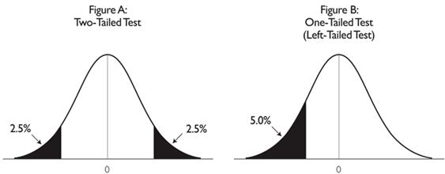

2. Constructing confidence intervals :
Illustration :
How these confidence intervals are obtained ?
We start from the Central limit Theorem which states that ${\sqrt{n}(\overline{X}}_{n}−θ)\sim N(0,1)$
Our goal is to find $ℙ_{θ}\left(a≤g\left(θ\right)≤b\right)≥1−α\text{,}$ for $α=5\%$, hence $ℙ_{θ}\left(a≤g\left(θ\right)≤b\right)≥95\%$
For a two-sided CI, we set $ℙ_{θ}\left(−a≤{\sqrt{n}(\overline{X}}_{n}−θ)≤a\right)≥95\%$
By taking for $a$ the $q_{97.5\%}$, we find : $ℙ_{θ}\left({\overline{X}}_{n}−\frac{q_{97.5\%}}{\sqrt{n}}≤θ≤{\overline{X}}_{n}+\frac{q_{97.5\%}}{\sqrt{n}}\right)≥95\%$
Fig A.
Two-sided CI
Fig B.
One-sided CI (left-sided)

Slide 6
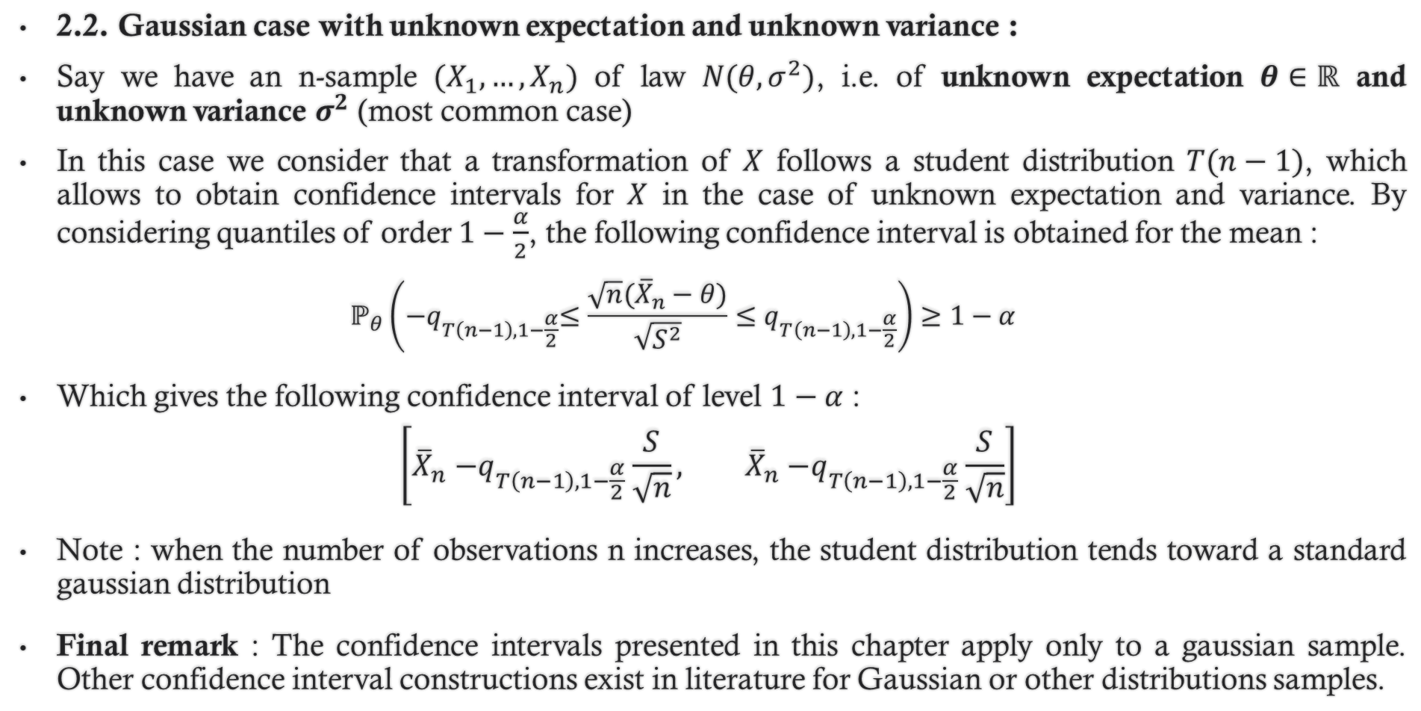
2. Constructing confidence intervals :
2.2. Gaussian case with unknown expectation and unknown variance :
Say we have an n-sample $(X_{1},…,X_{n})$ of law $N(θ,σ^{2})$, i.e. of unknown expectation $θ∈ℝ$ and unknown variance $σ^{2}$ (most common case)
In this case we consider that a transformation of $X$ follows a student distribution $T(n−1)$, which allows to obtain confidence intervals for $X$ in the case of unknown expectation and variance. By considering quantiles of order $1−\frac{α}{2}$, the following confidence interval is obtained for the mean :
$$ℙ_{θ}\left({−q}_{T\left(n−1\right),1−\frac{α}{2}}≤\frac{{\sqrt{n}(\overline{X}}_{n}−θ)}{\sqrt{S^{2}}}≤q_{T\left(n−1\right),1−\frac{α}{2}}\right)≥1−α$$
Which gives the following confidence interval of level $1−α$ :
$$\left[{\overline{X}}_{n}{−q}_{T\left(n−1\right),1−\frac{α}{2}}\frac{S}{\sqrt{n}}, {\overline{X}}_{n}{−q}_{T\left(n−1\right),1−\frac{α}{2}}\frac{S}{\sqrt{n}}\right]$$
Note : when the number of observations n increases, the student distribution tends toward a standard gaussian distribution
Final remark : The confidence intervals presented in this chapter apply only to a gaussian sample. Other confidence interval constructions exist in literature for Gaussian or other distributions samples.

